Slide 1

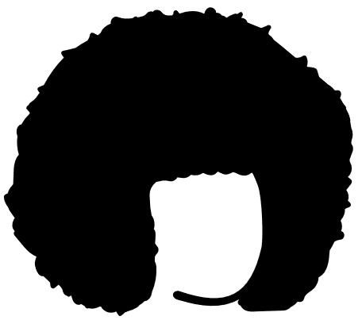
Black Hair : A Medium for Communicative and Cultural Expression
Prepared by Bensly Pierre
For CMNS 3600
On May 24, 2023
This Photo by Unknown Author is licensed under CC BY-NC-ND
Notes:
Introduction
Ice Breaker –Never had to present before since being in uni.

Slide 2
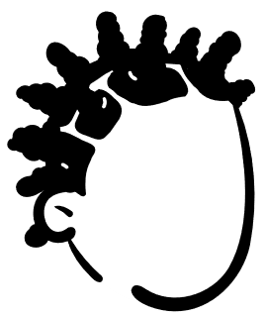
A Journey of Communication and Resistance
Hair is a temporary body modification but holds deep cultural significance.
Black hair has been a means of communication and expression for black people.
The texture, style, and length of black hair have always been used to express one's identity, social status, and cultural heritage (Byrd & Tharps, 2001).
In recent years, black hair has become a political statement, with many individuals using it as a means of challenging societal norms and promoting self-love and acceptance.
Notes:
Hair is not a permanent body modification. It has always been a way for black people to communicate, convey messages, and make statements about their identity and beliefs.
In this presentation I will take you on a journey through lens of history from its roots in West Africa and its evolution in the contemporary society as a form of self expression and political statement.

Slide 3
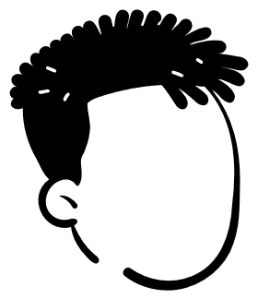
The History of Black Hair
During the 15th century in West Africa, hair was used to signify one’s marital status, tribe, or social status (Byrd & Tharps, 2001).
The more elaborate the hairstyle, the higher the individual's social status and rank in the hierarchy.
Braids, twists, and cornrows were popular styles that were passed down from generation to generation.
Notes:
Black hair has a rich history rooted in Africa. The intricate hairstyles of West Africa spoke volumes about an individual's marital status, tribe, and social hierarchy.
Just about everything about a person's identity could be learned by looking at the hair. You could even tell what someone’s surname was by their hair.
Since theses hairstyles took quite a bit of time to complete, in some cases multiple sessions, it became apart social of the social scene and children would watch and learn these hairstyles.
Reflecting upon the history of black hair, it becomes evident that it was not merely a matter of personal style, but rather a profound reflection of identity, heritage, and social standing.. These hairstyles were more than just aesthetic choices; they were a language of their own.

Slide 4

Oppression during Slavery
During the time of slavery, the hair of black people was frequently shaved or concealed with headscarves.
This was done as a means depriving them of their individuality and cultural heritage and exert control over their appearance.
Enslaved people resisted by creating intricate hairstyles as a form of communication
Braids, twists, and knots served as maps for the Underground Railroad (Luz Media, 2021)
Following the abolition of slavery, Black men and women started to embrace their natural hair to symbolize resistance against oppression.
Notes:
Then came slavery that brought immense challenges to the preservation of black hair as a form of communication.
Enslaved individuals faced the harsh reality of having their hair shaved or concealed, forcibly stripping them of their cultural heritage and individuality and also forcing them to conform to white beauty standards. This meant that they were unable to identify each other as they once did.
Though they did not have much time on their hand for hair styling, black people found creative ways to resist in the midst of oppression.
It was dangerous to be seen with a map and to combat this, Braids, twists, and knots were used as maps to help enslaved people escape by turning it into a secret language of freedom.
For example, the number of plaits an enslaved person wore would indicate “how many roads people needed to walk or where to meet someone to escape bondage”
These creative hairstyles were a way for slaves to maintain their cultural traditions and communicate with each other despite their oppressors' attempts to silence them.

Slide 5
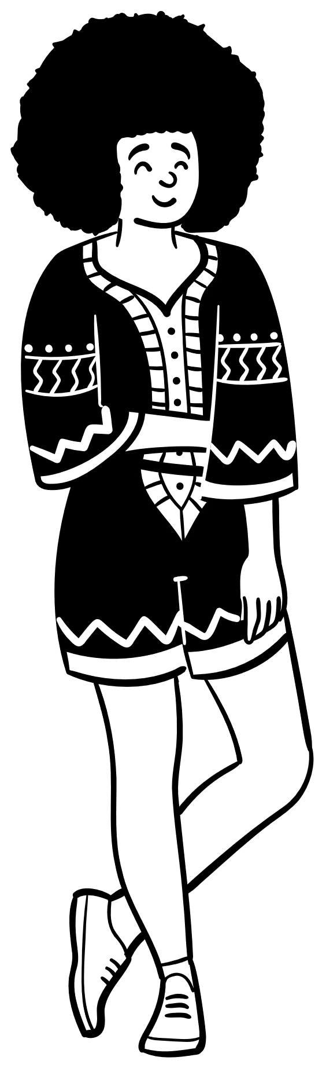
The Civil Rights Movement
During the Civil Rights Movement in the 1960s, black hair was used as a symbol of resistance and protest .
The afro hairstyle was embraced as a way to reject Eurocentric beauty standards and assert black identity and pride (The Well, 2021).
By growing out their hair and wearing it in natural styles, black people were able to assert their identity and challenge the mainstream narrative that only straight, sleek hair was acceptable (The Well, 2021).
Notes:
Fast forward to the Civil Rights Movement (1960s), and hair became a powerful symbol of resistance and protest against Eurocentric beauty standards and racial oppression.
The afro hairstyle, with its voluminous and natural texture, became an assertion of black identity and pride. It challenged the prevailing narrative that only straight, sleek hair was acceptable and instead celebrated the beauty of black hair in its natural form.

Slide 6
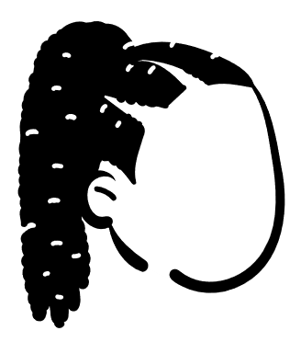
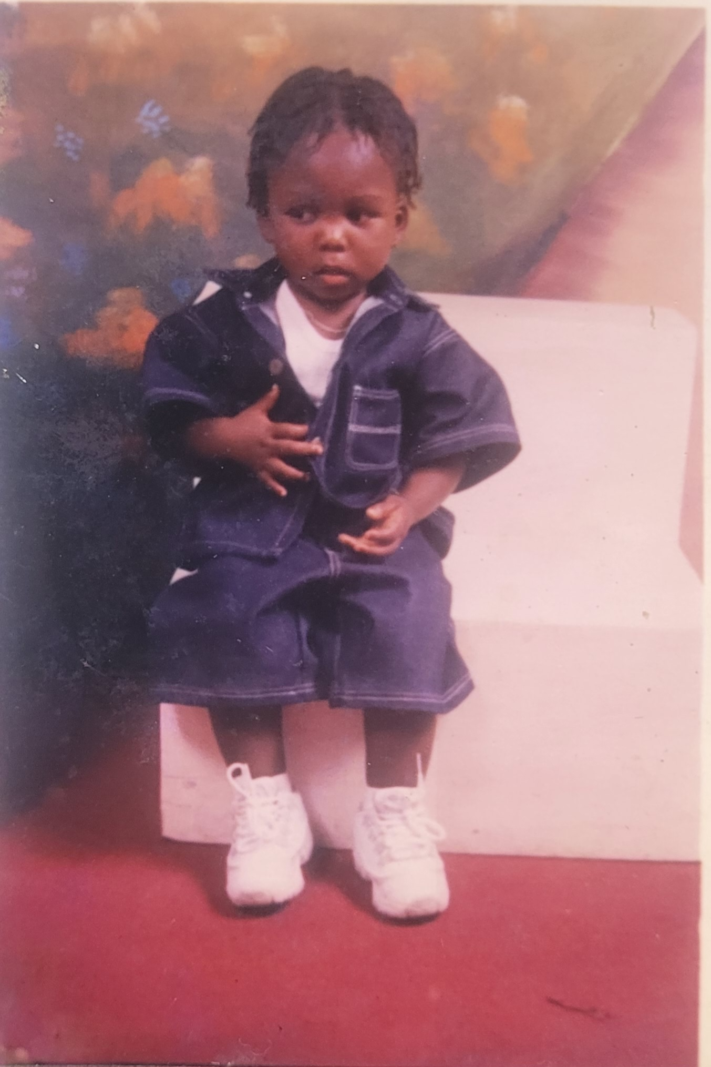
Black Hair Today
From intricate braids to colorful weaves, black hair has become a medium for self-expression and personal style.
In addition to being a form of body art, black hair is still used as a means of communication.
Certain hairstyles and textures can convey messages about one's identity, social status, and beliefs. These styles often incorporate cultural symbols and motifs, showcasing the rich history and heritage of black culture.
For example, dreadlocks have been associated with Rastafarianism and the reggae music scene, while afros were popularized during the Black Power movement of the 1960s and 1970s.
These hairstyles serve as a way for individuals to express their political and social views.
Notes:
Which bring us to today.
In contemporary society, black hair continues to be a vehicle for communication. From intricate braids to vibrant weaves, black hair has become an art form, a way to showcase creativity, and a celebration of cultural diversity.
Each hairstyle carries its own symbolism, conveying messages about personal beliefs, social status, and cultural affiliations.
Dreadlocks, for example, have become synonymous with Rastafarianism and reggae music, serving as a visual representation of spirituality and cultural pride. Through these hairstyles, people communicate their values, aspirations, and belonging to a particular community.
So much knowledge about our hair and how to care for it has been loss through the hand of slavery. For some, black hair has also become a means of reclaiming their culture and what they have lost.
Through it all, black hair has managed to retain some of its cultural significance:
In my culture, a male child’s hair is cut as a rite of passage to signify coming of age and knowledge of right and wrong. It is also believed that doing this too earlier will also negatively affect a child’s speech later on.
Christian women who are married are required to cover their hair in church which symbolizes their marital status which something I have not seen with Christians of other cultures.

Slide 7
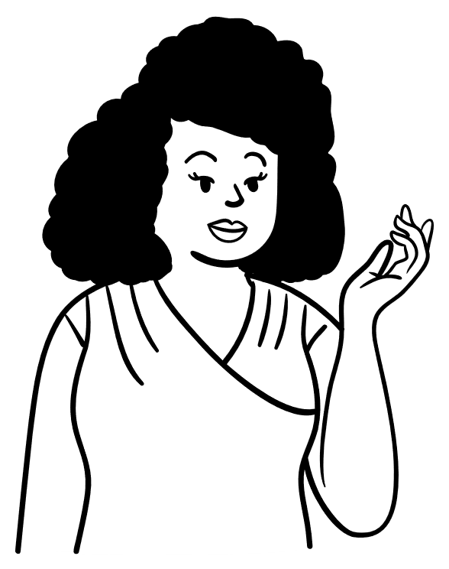
Discrimination and Appropriation of Black Hair
Today, black hair discrimination still exists in many parts of the world.
Many workplaces and schools have policies that prohibit natural hair styles such as afros, braids, and locs.
This discriminatory attitude often leads to instances of racism and microaggressions all while infringing upon an individual's right to express themselves freely.
Additional, non-black people frequently appropriate these hairstyles without acknowledging their cultural significance or the struggles that black people have faced in wearing them (The Ard, 2022).
Notes:
Despite the richness and significance of black hair, it continues to face discrimination and appropriation in various settings.
Workplace and school policies that restrict natural hairstyles perpetuate harmful stereotypes and limit self-expression. Such discriminatory practices undermine the dignity and cultural heritage of black individuals, denying them the freedom to embrace their natural hair and express their authentic selves. And because of this, up until recently, I would alter my hairstyles when going to job interviews.
Moreover, non-black individuals often appropriate black hairstyles without acknowledging their cultural significance or the struggles that black people have faced in wearing them.
As seen in the media with some white celebrities. It’s considered trendy on white woman but unprofessional on a black woman.
It is essential to foster understanding and respect, recognizing that black hair is not just a trend or a fashion statement but a deeply rooted expression of identity and heritage.

Slide 8
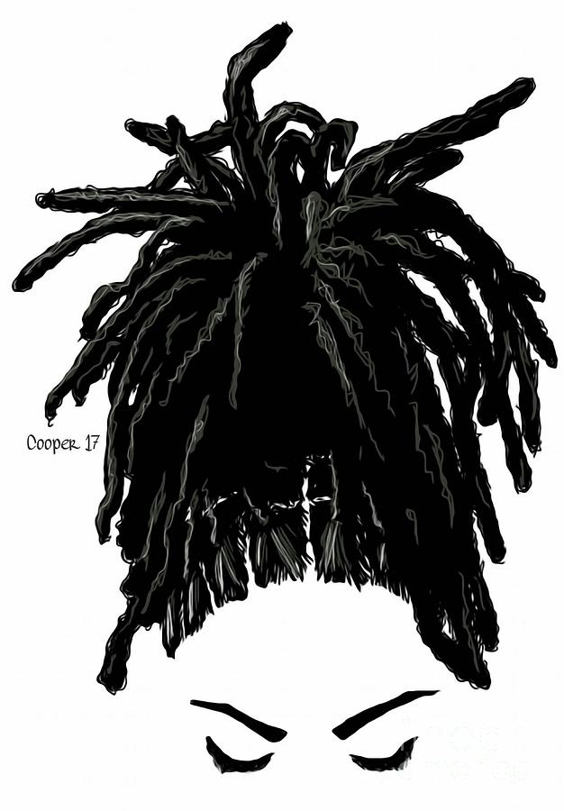
Scrutiny within Black Communities and Faiths
The issue of internalized discrimination in black communities is a concern, particularly when it comes to the scrutiny and perpetuation of Eurocentric beauty standards.
For instance, some high school rules may unfairly target black students' hair length.
Notes:
The scrutiny and perpetuation of Eurocentric beauty standards within black communities also warrant attention. The internalized discrimination that exists in some black communities, particularly regarding hair length and texture, reflects the ongoing influence of societal pressures and limited notions of beauty.
Such scrutiny further marginalizes individuals who choose to embrace their natural hair, undermining their self-esteem and reinforcing the need to conform to mainstream beauty norms.
When you have been told for thousands of years that your hair unruly, unprofessional and unacceptable, it becomes even harder to untangle Black hair from these harmful stereotypes. In some way or form you begin to perpetuate the very same stereotypes.
If you would have read my forum post on this, you have seen that I mentioned that I would not be allowed in a school setting at home with this hairstyle. It has to be ¼ of an inch or less since it was deemed unprofessional and associated with delinquent behavior.
In my experience, I noticed that some of this policing around black hair have been enforced by religious ideologies.
Which brings me to the aim of my research which is to demonstrate that the appropriation and discrimination of black hair even within the black community extend far beyond individual experiences, rather, it reflect deeper issues of cultural erasure and systemic racism.

Slide 9
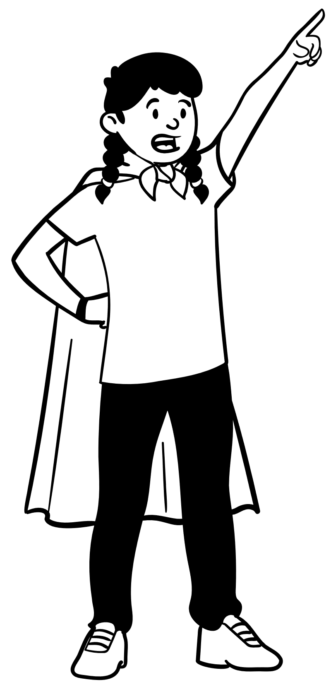
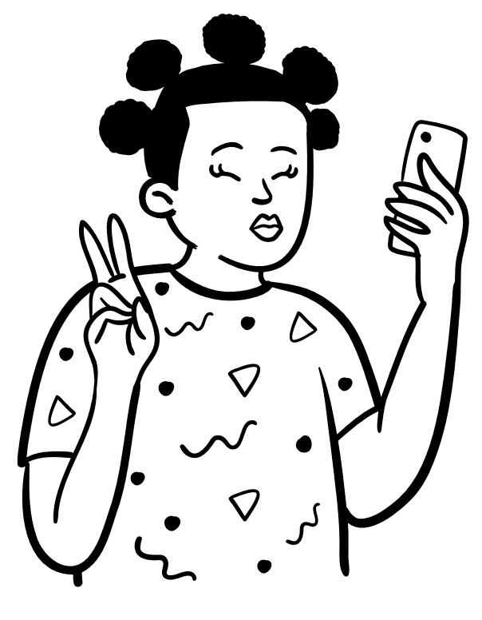
Recent Debates and Progress
The fight for hair equality continues, with many individuals advocating for legislation to protect black hair.
The prohibition of dreadlocks on a Jamaican student has stirred controversy, as reported by the Jamaica Gleaner in 2021.
In 2019, CNN reported on California's ban on discrimination against natural hair.
Notes:
Continuing the conversation
Recently, a ban placed on child at a school in Jamaica over her dreadlocks have sparked quite a debate urging both the supreme court and the ministry of education to intervene (Jamaica Gleaner, 2021).
In 2019, California became the first state to ban discrimination based on natural hair, recognizing that hair is a fundamental part of a person's identity (CNN, 2019).
While progress has been made, black people still face discrimination based on their hair, and I believe it is essential to continue to raise awareness and fight against this form of oppression and create a more inclusive and equitable society.

Slide 10
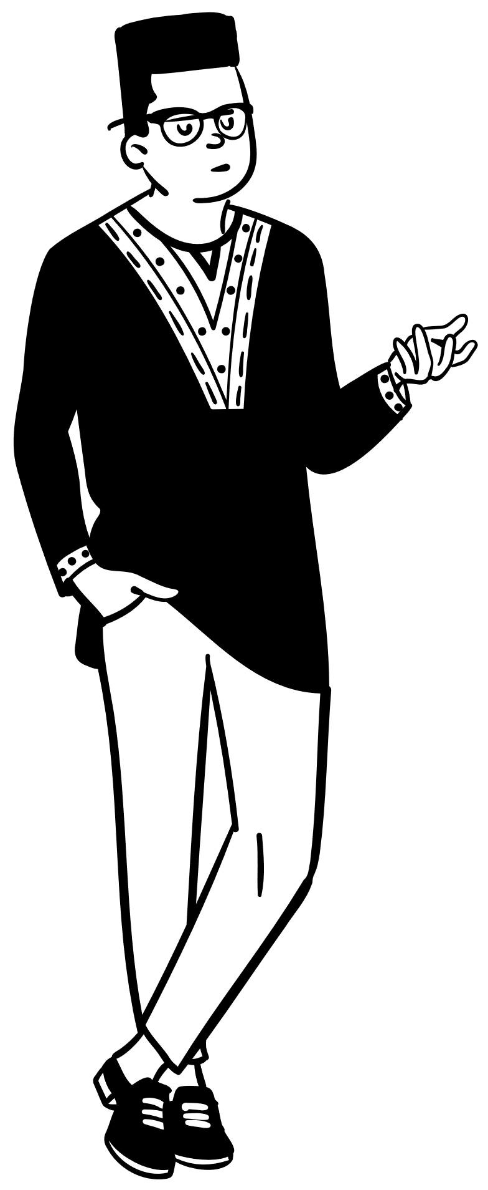
Conclusion
Black hair is more than just hair - it is a form of body art and communication that has been used for centuries to express one's identity, culture, and beliefs.
The continued problems of discrimination and appropriation serve as a reminder of the need for change to address these issues.
As we continue to push for hair equality and celebrate the beauty of black hair, it is important to remember the rich history and heritage behind these styles and the messages they convey.
Notes:
In conclusion, the discrimination and appropriation of black hair highlight broader issues of cultural erasure and systemic racism.
It is crucial to recognize and address the biases embedded within societal norms and policies that perpetuate discrimination against black hairstyles.
By actively advocating for change, fostering inclusive environments, and celebrating the cultural heritage and expressions of black hair, we can work towards a more equitable and respectful society for all.

Slide 11
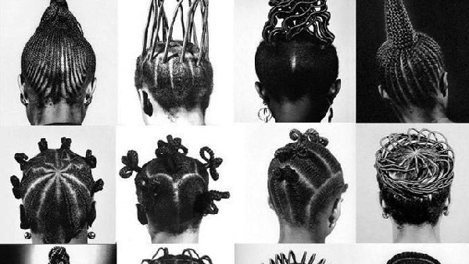
Cornrows (MyNigeria, 2021)

Slide 12
References
Byrd, A. & Tharps, L. (2001). Hair Story: Untangling the Roots of Black Hair in America. New York: St. Martin’s Press.
CNN. (2019, July 4). California becomes the first state to ban discrimination based on natural hairstyles | CNN. CNN. https://www.cnn.com/2019/07/03/us/california-hair-discrimination-trnd
Jamaica Gleaner (2021, June 14). MOE warns schools against barring students over hairstyles. Jamaica-Gleaner.com. https://jamaica-gleaner.com/article/news/20210614/moe-warns-schools-against-barring-students-over-hairstyles
Luz Media (2021, October). How Hair Has Been a Form of Resistance Over the Years. Luz Media; Luz Media. https://luzmedia.co/how-hair-has-been-a-form-of-resistance-over-the-years
MyNigeria [Photograph] (2023). Mynigeria.com. https://cdn.mynigeria.com/imagelib/pics/807/80797698.jpg
The ARD (2022, August 11). Respect the Roots of Black Hair. Anti-Racism Daily; Anti-Racism Daily. https://the-ard.com/2022/08/11/hair-discrimination-and-appropriating-black-hair/
The Well (2022). What Everyone Needs to Know About Black Hair History. The-Well.com. https://www.the-well.com/editorial/what-everyone-needs-to-know-about-black-hair-history
All illustrations are sourced from Microsoft PowerPoint Stock Images.

Slide 13

Questions?

